Slide 1
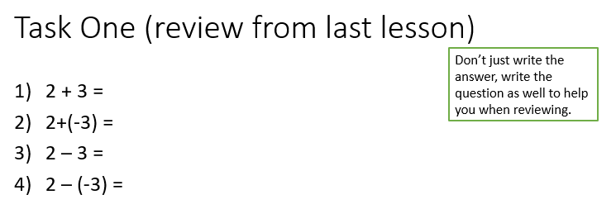
Topic: Measurement
EQ – How do I convert between units of length and area?
Second topic so don’t forget to add to Contents page in INB
Get your VIVO’s
Topic and EQ in Interactive Notebook
NO PHONES OR EAR BUDS
Have a go:
Notes:
In the have a go section wi

Slide 2
Contents
Formula Page
Page
Date
Description
2
3

Slide 3

24
7
30
Date
Measurement
EQ – How do I covert between metric units of length and area?
Summary
Simplify $7p+5t−12p+9$
Simplify $−5ed×7ef$
$−4+7×−3=$
.
5

Slide 4

24
7
30
Date
Measurement
EQ – How do I covert between metric units of length and area?
Summary
Simplify $7p+5t−12p+9=5t−5p+9$
Simplify $−5ed×7ef=−35{de}^{2}f$
$−4+7×−3=−25$
.
5

Slide 5
24
7
30
Date
Measurement
EQ – How do I covert between metric units of length and area?
5

Slide 6
24
7
30
Date
Measurement
EQ – How do I covert between metric units of length and area?
Converting Units
Converting Units
km m cm mm
km m cm mm
5

Slide 7
24
7
30
Date
Measurement
EQ – How do I covert between metric units of length and area?
Converting Units
Converting Units
km m cm mm
km m cm mm
5

Slide 8
24
7
30
Date
Measurement
EQ – How do I covert between metric units of length and area?
Converting Units
Converting Units
km m cm mm
km m cm mm
5

Slide 9
24
7
30
Date
Measurement
EQ – How do I covert between metric units of length and area?
Converting Units
Converting Units
km m cm mm
km m cm mm
5

Slide 10
24
7
30
Date
Measurement
EQ – How do I covert between metric units of length and area?
Converting Units
Converting Units
x1000
km m cm mm
km m cm mm
5

Slide 11
24
7
30
Date
Measurement
EQ – How do I covert between metric units of length and area?
Converting Units
Converting Units
x1000 x 100
km m cm mm
km m cm mm
5

Slide 12
24
7
30
Date
Measurement
EQ – How do I covert between metric units of length and area?
Converting Units
Converting Units
x1000 x 100 x10
km m cm mm
km m cm mm
5

Slide 13
24
7
30
Date
Measurement
EQ – How do I covert between metric units of length and area?
Converting Units
Converting Units
x1000 x 100 x10
km m cm mm
km m cm mm
5

Slide 14
24
7
30
Date
Measurement
EQ – How do I covert between metric units of length and area?
Converting Units
Converting Units
x1000 x 100 x10
km m cm mm
km m cm mm
5

Slide 15
24
7
30
Date
Measurement
EQ – How do I covert between metric units of length and area?
Converting Units
Converting Units
x1000 x 100 x10
km m cm mm
km m cm mm
5

Slide 16

24
7
30
Date
Measurement
EQ – How do I covert between metric units of length and area?
Converting Units
Converting Units
x1000 x 100 x10
km m cm mm
km m cm mm
$÷$1000
5

Slide 17

24
7
30
Date
Measurement
EQ – How do I covert between metric units of length and area?
Converting Units
Converting Units
x1000 x 100 x10
km m cm mm
km m cm mm
$÷$1000 $÷$100
5

Slide 18

24
7
30
Date
Measurement
EQ – How do I covert between metric units of length and area?
Converting Units
Converting Units
x1000 x 100 x10
km m cm mm
km m cm mm
$÷$1000 $÷$100 $÷$10
5

Slide 19
24
7
30
Date
Measurement
EQ – How do I covert between metric units of length and area?
Converting Units
Converting Units
x1000 x 100 x10
km m cm mm
km m cm mm
$÷$1000 $÷$100 $÷$10
Change the following to the given units
5m to cm
780mm to cm
2.4km to cm
5

Slide 20
24
7
30
Date
Measurement
EQ – How do I covert between metric units of length and area?
Converting Units
Converting Units
x1000 x 100 x10
km m cm mm
km m cm mm
$÷$1000 $÷$100 $÷$10
Change the following to the given units
5m to cm
780mm to cm
2.4km to cm
5

Slide 21
24
7
30
Date
Measurement
EQ – How do I covert between metric units of length and area?
Converting Units
Converting Units
x1000 x 100 x10
km m cm mm
km m cm mm
$÷$1000 $÷$100 $÷$10
Change the following to the given units
5m to cm 5 x100 = 500cm
780mm to cm
2.4km to cm
5

Slide 22
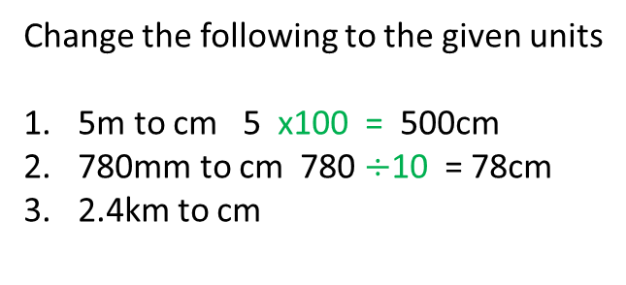
24
7
30
Date
Measurement
EQ – How do I covert between metric units of length and area?
Converting Units
Converting Units
x1000 x 100 x10
km m cm mm
km m cm mm
$÷$1000 $÷$100 $÷$10
Change the following to the given units
5m to cm 5 x100 = 500cm
780mm to cm 780 $÷$10 = 78cm
2.4km to cm
5

Slide 23
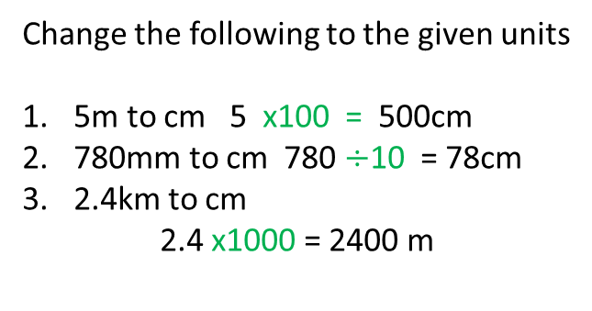
24
7
30
Date
Measurement
EQ – How do I covert between metric units of length and area?
Converting Units
Converting Units
x1000 x 100 x10
km m cm mm
km m cm mm
$÷$1000 $÷$100 $÷$10
Change the following to the given units
5m to cm 5 x100 = 500cm
780mm to cm 780 $÷$10 = 78cm
2.4km to cm
2.4 x1000 = 2400 m
5

Slide 24
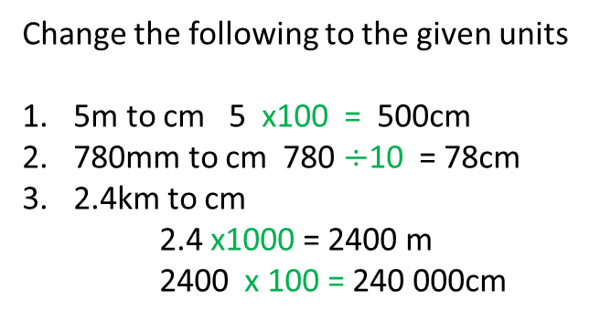
24
7
30
Date
Measurement
EQ – How do I covert between metric units of length and area?
Converting Units
Converting Units
x1000 x 100 x10
km m cm mm
km m cm mm
$÷$1000 $÷$100 $÷$10
Change the following to the given units
5m to cm 5 x100 = 500cm
780mm to cm 780 $÷$10 = 78cm
2.4km to cm
2.4 x1000 = 2400 m
2400 x 100 = 240 000cm
5

Slide 26
Guided Practice
Converting Units worksheet
Metric Length puzzle

Slide 27
What about converting between area units?
Notes:
Add in flow chart of area units

